Slide 1
Impressionist Artist
Claude Monet

Slide 2
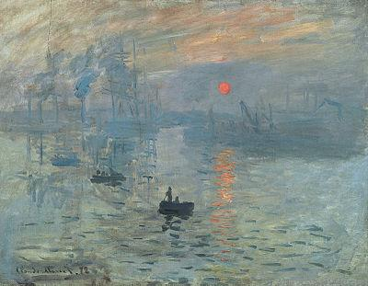
Impressionism
Is a 19th century art movement that
originated with a group of Paris-based
artists. Their style was not well liked until
the 1870’s and 1880’s. Artists such as
Claude Monet, Paul Cezanne, Camille
Pissarro and Edouard Manet started the
movement. It soon attracted other artists
such as Sisley, Renoir, and Edgar Degas.
Impressionism was coined after Claude Monet’s painting to the
Right. Its title is “Impression” painted in 1872. Critic Louis
LeRoy accidentally coined the phrase during a satirical review
of the art show in which Monet’s painting was displayed.

Slide 3
Focus: Light and Movement
Artists began focussing on light and how natural light (the Sun) changed throughout the day and year. Painting in series such as “Haystacks” and “Water Lilies” allowed artists a chance to capture realistic qualities of a single item or area in much different ways.
In the painting “Impression”, which accidentally coined the term in which this style of painting was named, Monet captured the sun in a realistic way that only humans can see...Lets see how it works!

Slide 4
What’s the “brightest” area on this painting? Be ready to support your answer with a reason!!

Slide 5
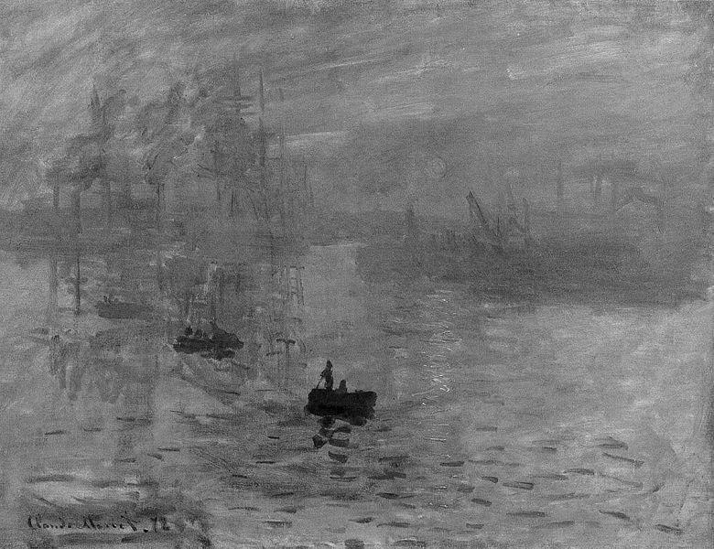
Can you see the sun now?? Why can we see it so well in the color painting but not at all in the black and white version???

Slide 6
Impressionist Technique
To understand how this type of painting was created, you have to understand that this style of modern painting began with a new invention. During the mid 19th Century, pre-mixed paints were created. These paints came in metal tubes (much like toothpaste today) that allowed artists to travel with their paints inside and outside. Before this invention, artists made their own paints by mixing dry pigments and powders with linseed oil and storing them in animal bladders!
Short thick strokes of paint capture the “essence” of subjects, rather than the details. The paint was applied“impasto” meaning the paint is very thick. It often leaves ridges when dried and allows the viewer to see brush strokes from the actual painting process.
Colors are applied side by side. Optical mixing of the paints occurs in the viewers eyes.
Grays and dark tones are created by mixing Complementary Colors…pure impressionism avoids the use of black!
Close attention is paid to light reflecting from object to another object.

Slide 7
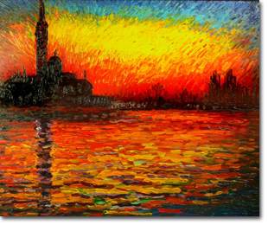
Lets see some of Monet’s work!

Slide 8
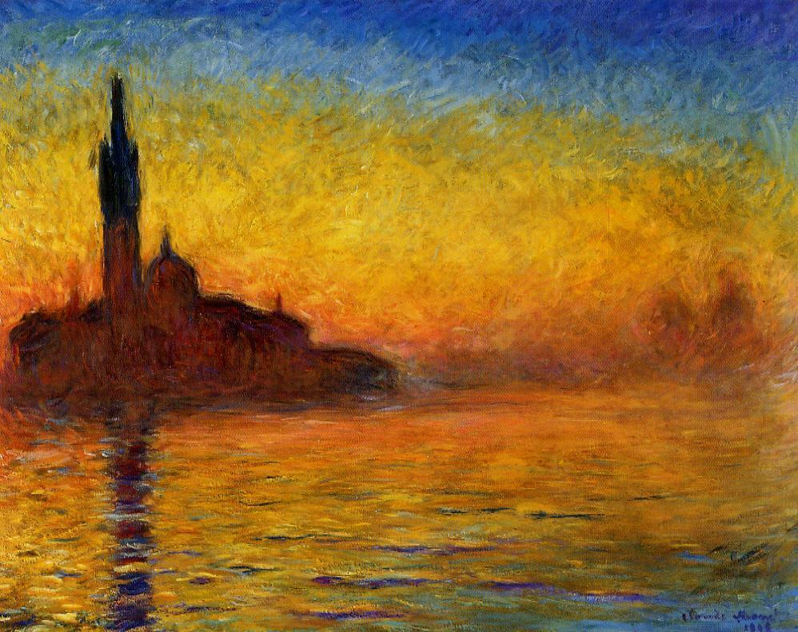

Slide 9
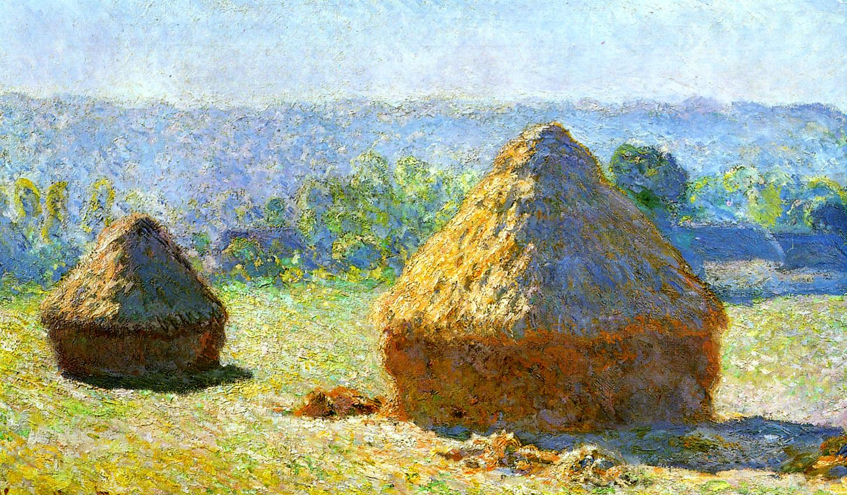
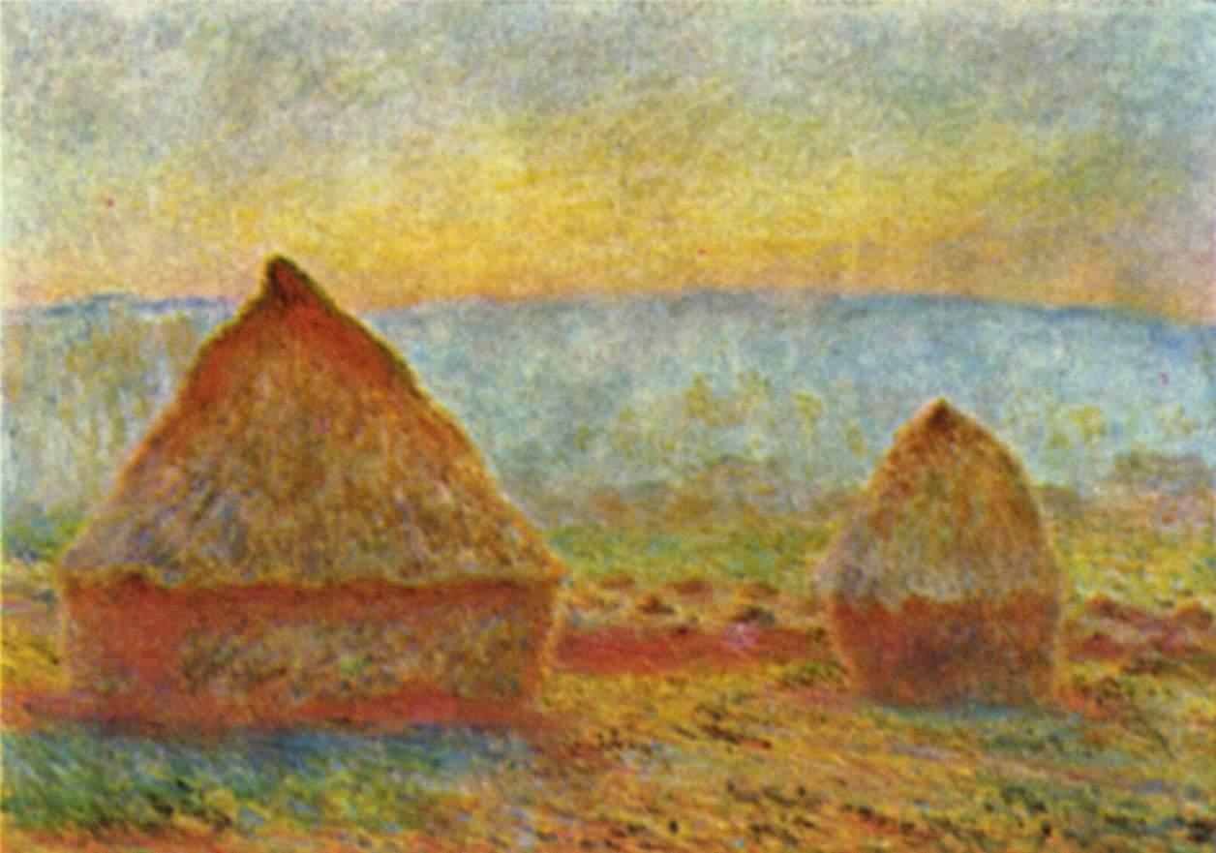
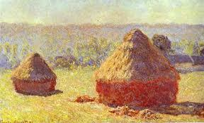
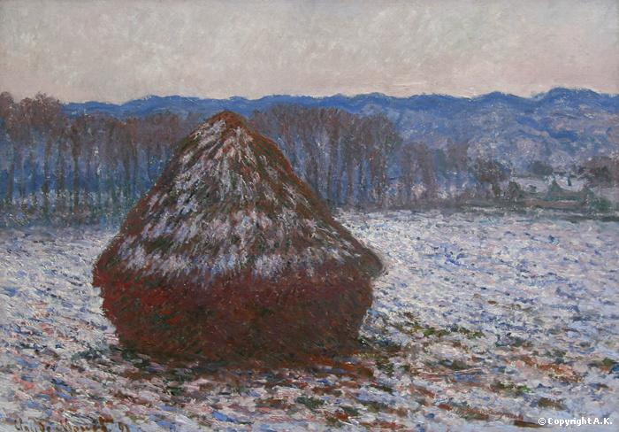

Slide 10
