Slide 1
Op Art
- Optical Art: An Illusion to the Human Eye!

Slide 2
When It Began:
In 1964 The phrase “Optical Art” was coined by Time Magazine. “Op Art” as it was later called, referred to the new style of art which often created Illusions and at times it seemed to be breathing or moving!
The 1960’s in America, were full of new ideas and movements. The Beatles from Britain changed the world and music, the Civil Rights movement was in full swing and the assassination of President Kennedy still had America spinning...the setting was right for a change in art and a new style of Art was born.

Slide 3
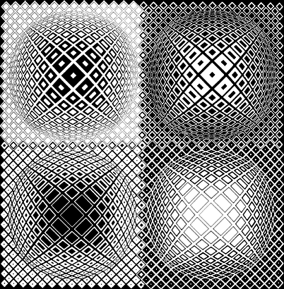
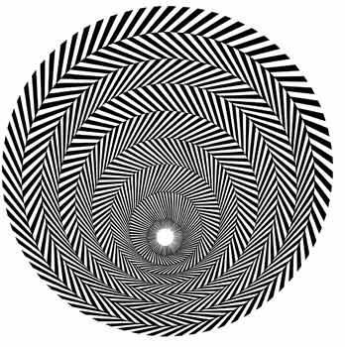
What is “Op Art”?
At first look Op Art seems to be just black and white lines...some people feel a child with a computer program could create this kind of art rather easily!
- What if they didn’t have computers?
- How could they do it without a computer?

Slide 4
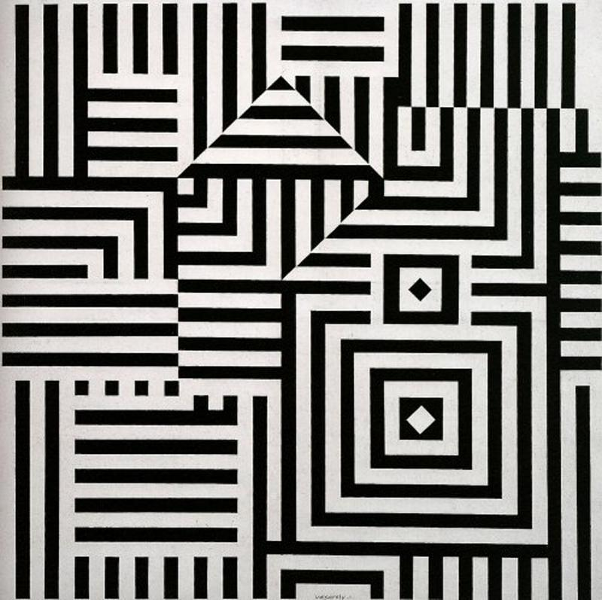
Math Based Art??
If you look closely, you can see several lines shapes and forms we have already talked about...Where can you see math in the picture? Why would the artist use Math in their art work?

Slide 5
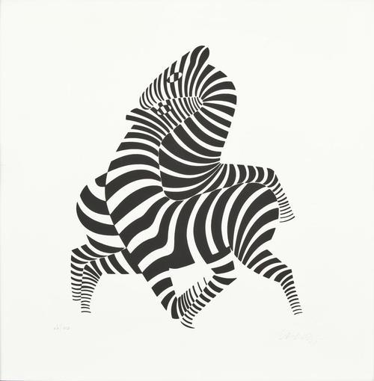
How it Started!
Victor Vasarely began the movement in 1938 with his work called Zebra.
Best known as the "father" figure of Op Art, Vasarely went through a number of styles to get there.
He used Geometric shapes and Mathematical precision to perfect the style of Op Art!

Slide 7
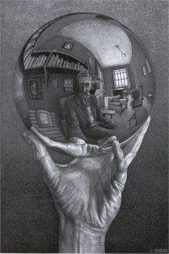
M.C. Escher
Another Influence on the Op Art movement was an artist by the name of M. C. Escher. Escher was known for crazy designs which at first look, appear normal but by studying the design you can find irregularities or “problems”.
Lets see if you can find them...

Slide 8
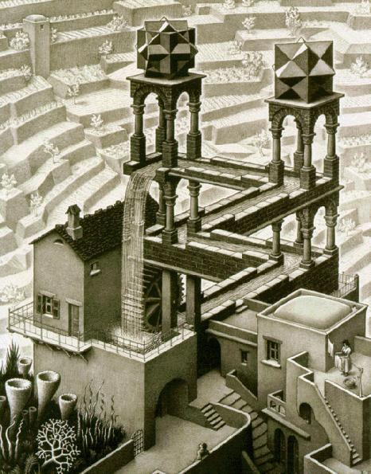

Slide 9
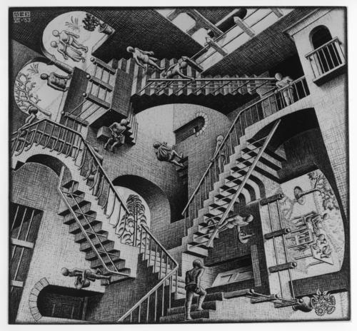

Slide 10
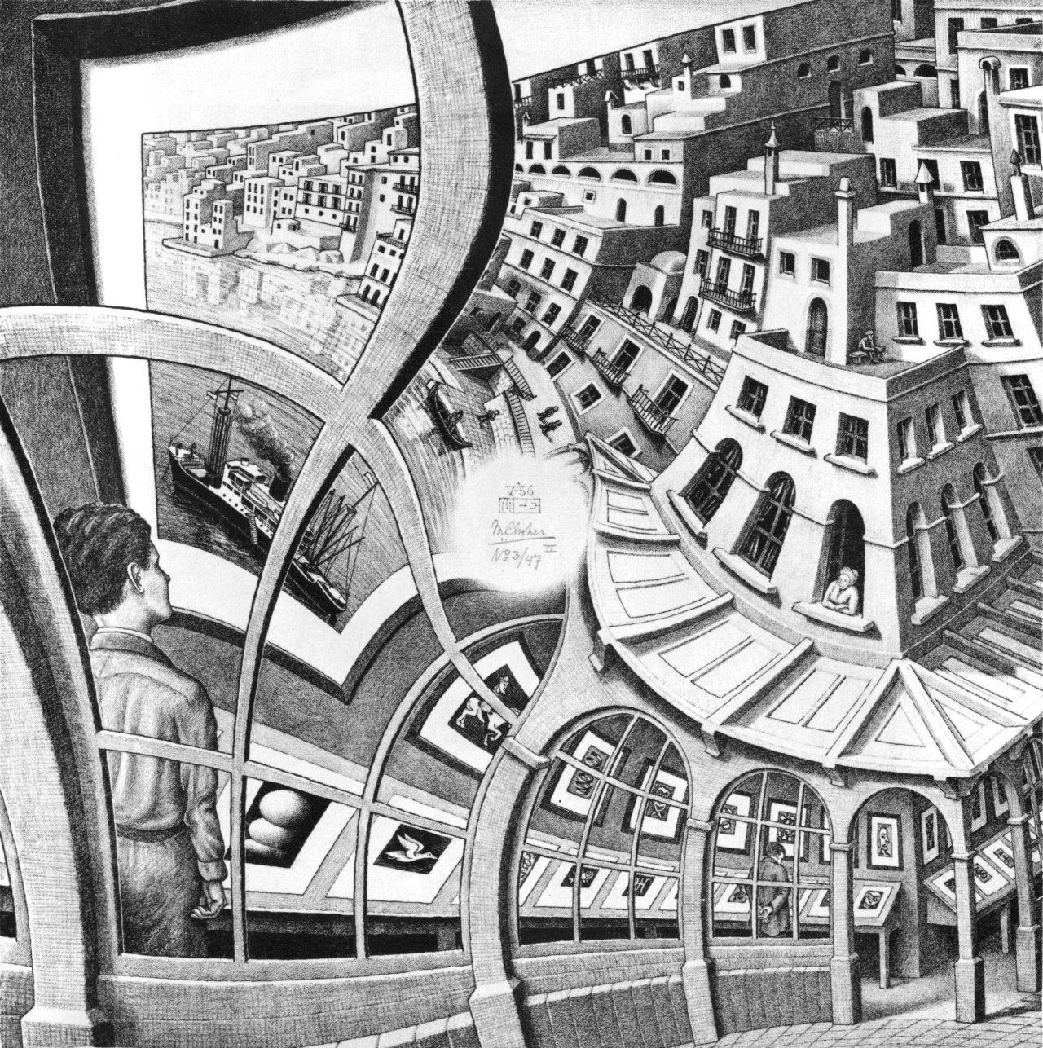

Slide 11
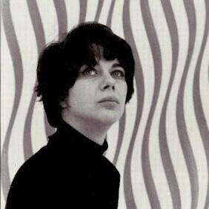
Famous Op Art Artist!
Bridget Riley is probably the most famous of Op Art artists. She began her studies of line, shape and light prior to the term Optical Art being coined.
Her works were done mainly in black and white but later she began exploring color in her works.
She was born in 1931 in London, France and is still alive today.

Slide 12
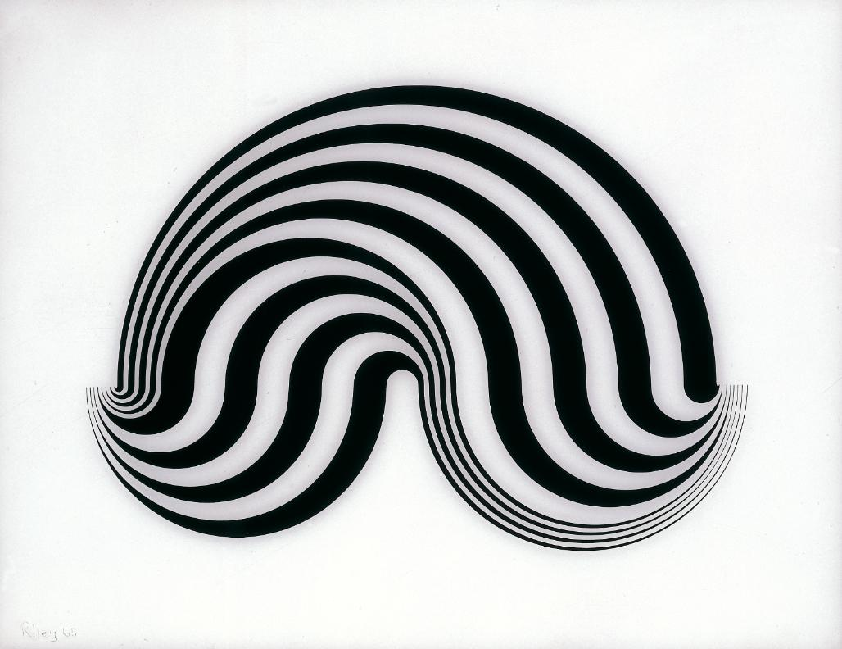
Some of her Art...
Can you find Math and Geometry in her work?

Slide 13
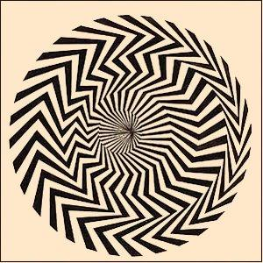

Slide 14
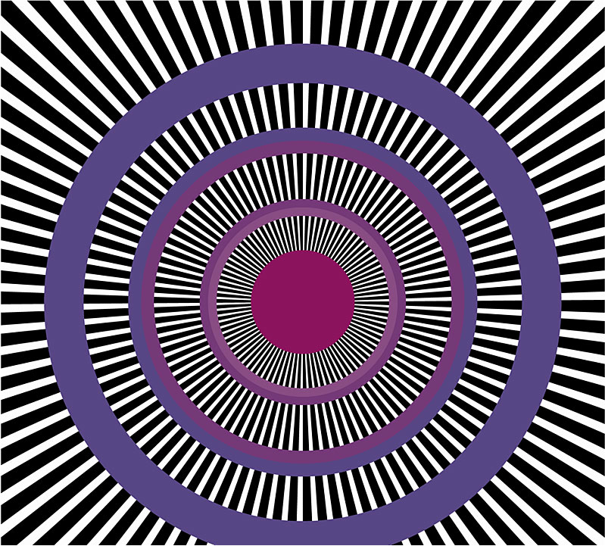

Slide 15
What Makes it Move?
On one hand we have black and white lines and shapes that appear to move and even become blurred together.
The black and white colors work together to create movement because of the contrast between the two colors.
On the other hand we have lines that create movement...how do the lines work together to create movement?
Each line appears to move because of space and width of the lines. Lines closer together seem farther away while lines spaced apart seem closer.

Slide 16
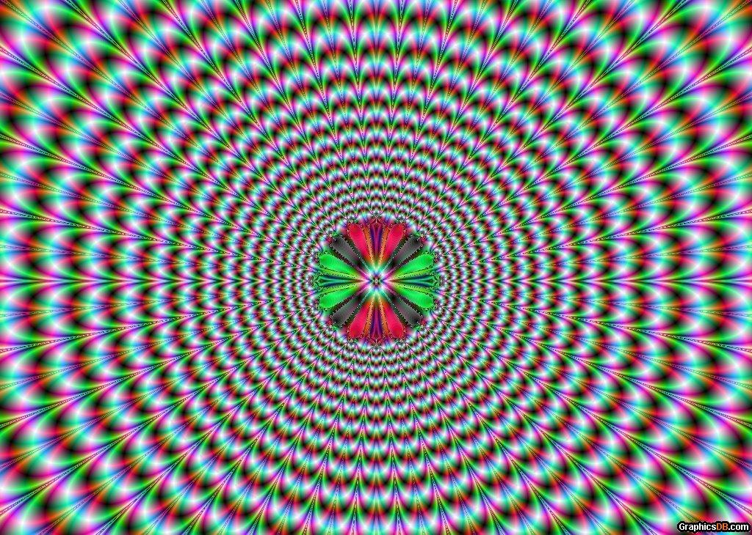
Lets take a closer look!

Slide 17
Back to the Future!

